Slide 1
Loops
David Tarvin, AIM Code School

Slide 2
Purpose Of Loops
Execute a code block repeatedly based on a certain condition
Automate repetitive tasks so you don’t need to repeat code multiple times
Repeating operations a certain number of times
Repeating operations until a condition is met
Iterating over data sets, arrays, and objects
Iteration – the repeated execution of statements

Slide 3
Types of Loops
for loops – run a block of code a specified number of times
while and do-while loops – run a block of code repeatedly while a condition is true
Will usually run an unspecified number of times

Slide 4
For loops
for loops use a counter to execute code a certain number of times
Three parts to a for loop
Counter initialization –initializes the counter variable and sets its starting value
Condition – states what condition must be true for the loop to keep repeating
Counter update – changes the value of the counter every time the loop runs

Slide 5
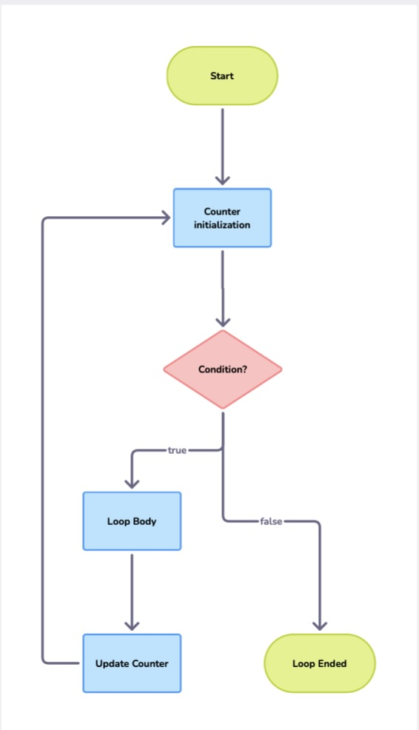


Slide 6

For loops (cont’d)

Slide 7
Value of i before checking condition | Is condition met? | Execute Loop Body? | Console log output | Value of i after updating
1 | 1 <= 5 true | Yes | Number 1 | 2
2 | 2 <= 5 true | Yes | Number 2 | 3
3 | 3 <= 5 true | Yes | Number 3 | 4
4 | 4 <= 5 true | Yes | Number 4 | 5
5 | 5 <= 5 true | Yes | Number 5 | 6
6 | 6 <= 5 false | No | Loop ended

Slide 8
while loops
while loops use a condition, not a counter, to check whether a loop should continue
while loops are generally used when you don’t know how many iterations of the loop will occur
while loops check the condition at the beginning of the loop

Slide 9
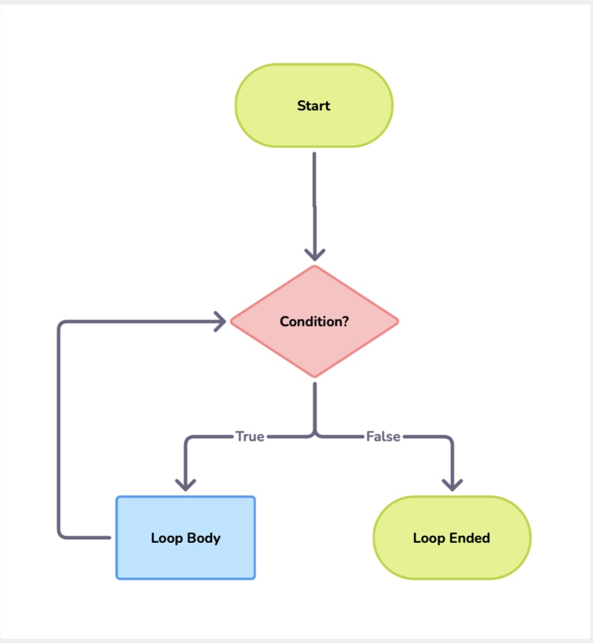


Slide 10
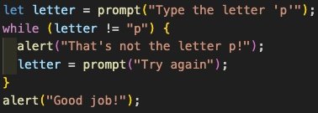

Slide 11
While loop – first run
Prompt | Value of letter | Is condition met? (letter !== “p”) | Execute loop body? | Alert
“Type the letter ‘p’” | “h” | true | Yes | “That’s not the letter p!”
“Try again” | “s” | true | Yes | “That’s not the letter p!”
“Try again” | “;” | true | Yes | “That’s not the letter p!”
“Try again” | “P” | true | Yes | “That’s not the letter p!”
“Try again” | “2” | true | Yes | “That’s not the letter p!”
“Try again” | “p” | false | No | “Good job!”

Slide 12
While loop – second run
Prompt | Value of letter | Is condition met? (letter !== “p”) | Execute loop body? | Alert
“Type the letter ‘p’” | “j” | true | Yes | “That’s not the letter p!”
“Try again” | “4” | true | Yes | “That’s not the letter p!”
“Try again” | “N” | true | Yes | “That’s not the letter p!”
“Try again” | “p” | false | No | “Good job!”

Slide 13
While loop – third run
Prompt | Value of letter | Is condition met? (letter !== “p”) | Execute loop body? | Alert
“Type the letter ‘p’” | “p” | false | No | “Good job!”

Slide 14
Do-while loop
Like while loops, do-while loops use a condition to check whether a loop should continue
Like while loops, do-while loops are generally used when you don’t know how many iterations of the loop will occur
do-while loops check the condition at the end of the loop

Slide 15
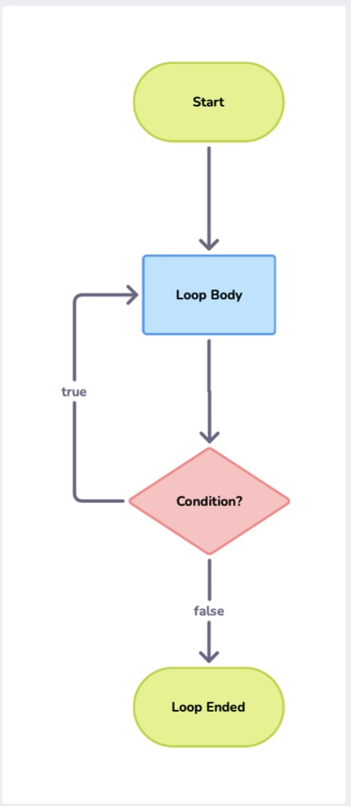


Slide 16
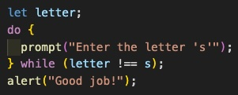

Slide 17
Execute loop body? | Prompt | Value of letter | Is condition met? (letter !== “s”) | Alert
Yes | “Enter the letter ‘s’” | “p” | true
Yes | “Enter the letter ‘s’” | “r” | true
Yes | “Enter the letter ‘s’” | “6” | true
Yes | “Enter the letter ‘s’” | “s” | false | “Good job!”
No

Slide 18
Difference between while loops and do-while loops
A while loop checks its condition at the beginning of the loop – if the condition is false to begin with, the loop won’t run
A do-while loop checks its condition at the end of the loop – the loop body is guaranteed to run at least once, even if the condition is false to begin with

Slide 19
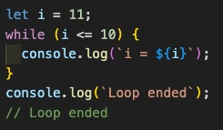
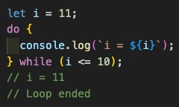
While loop vs do-while loop

Slide 20
